Slide 1
Big Data Processing
Jiaul Paik
Lecture 3

Slide 2
Characteristics of Big Data
Volume:
the size and amounts of big data
Variety:
the diversity and range of different data types (unstructured data, semi-structured data, video, image etc)
Velocity (known as streaming data):
the speed at which data is coming
e.g., social media posts or search queries received within a day/hour
Variability:
the changing nature of the data companies seek to capture, manage and analyze
– e.g., in sentiment or text analytics
Veracity:
the “truth” or accuracy of data and information
Value:
the value of big data comes from interesting pattern recognition that lead to better decision making

Slide 3
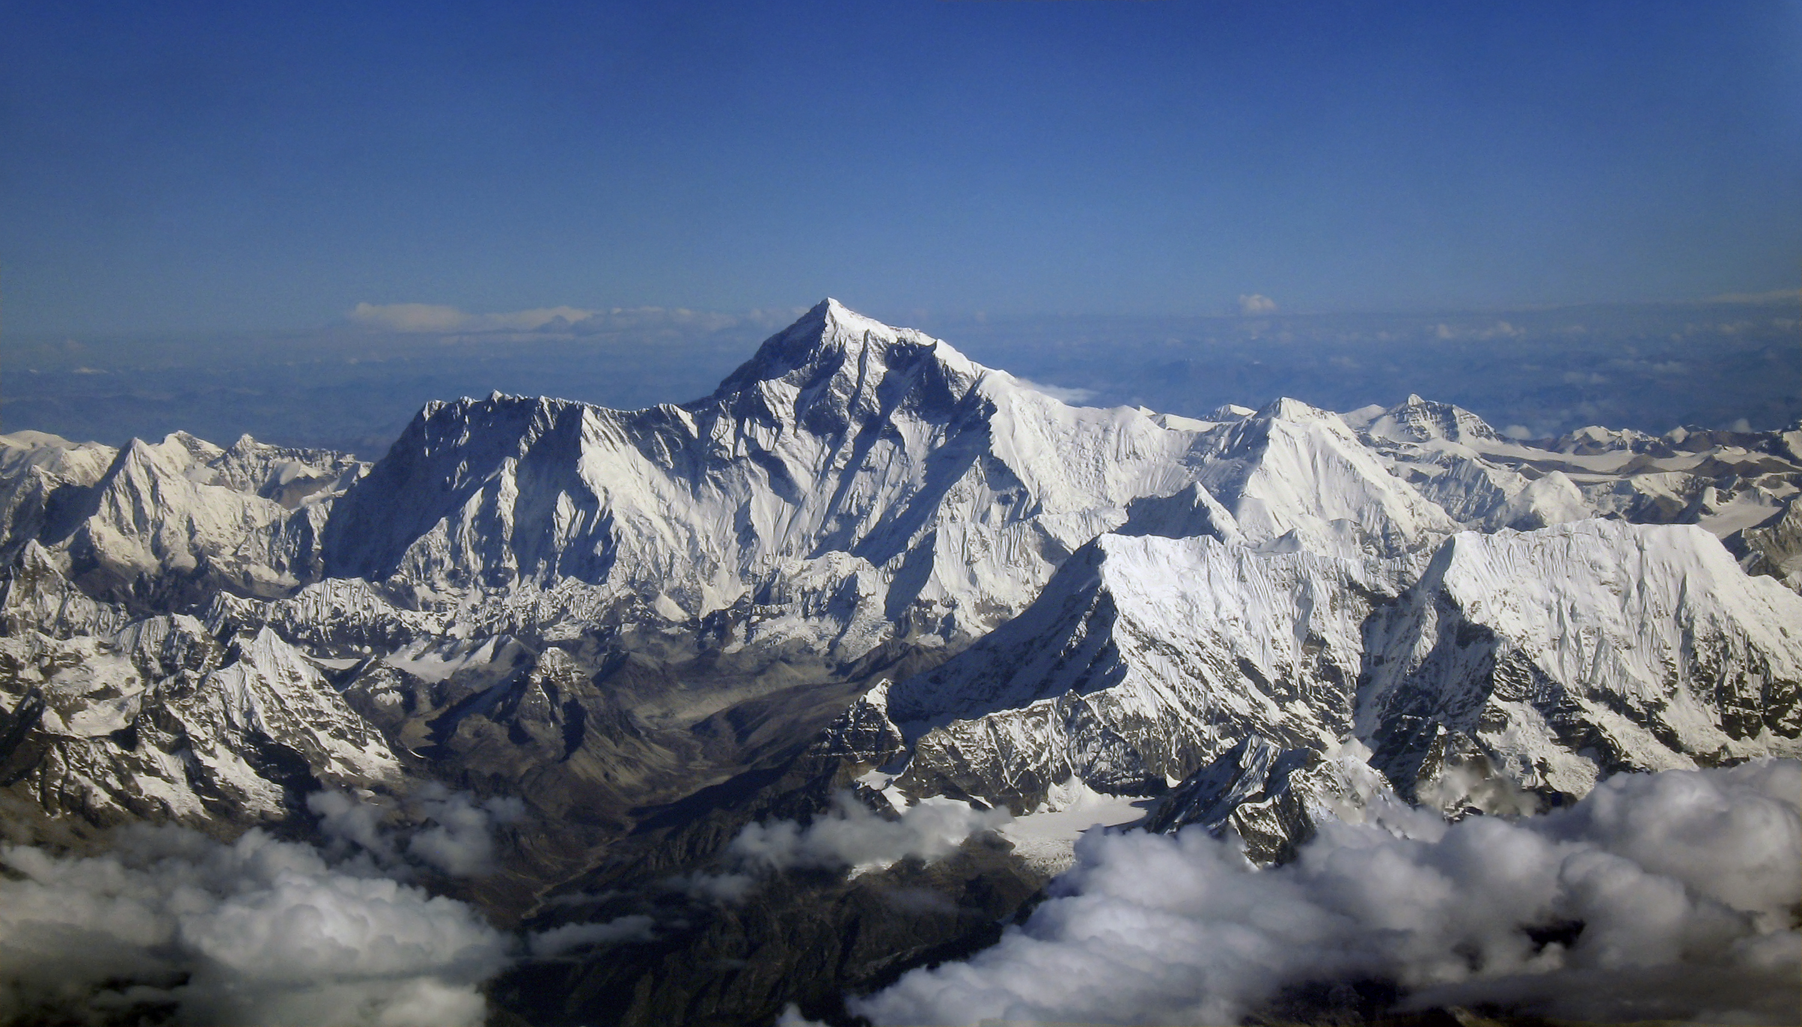
Science
Why big data?
Engineering
Commerce
Society
Source: Wikipedia (Everest)

Slide 4
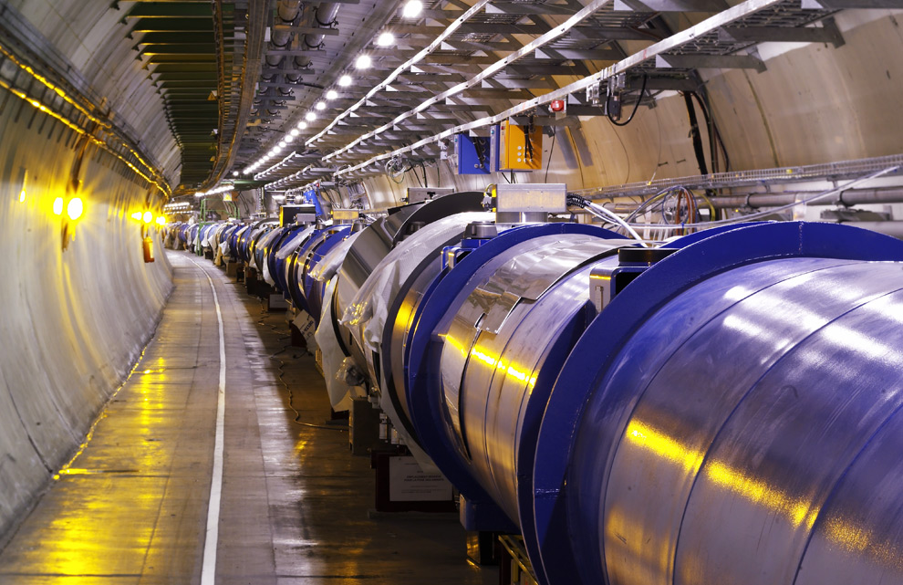
Science
Data-intensive Science
Large Hadron collider: Particle collider
15 Petabyte/year
Maximilien Brice, © CERN

Slide 5
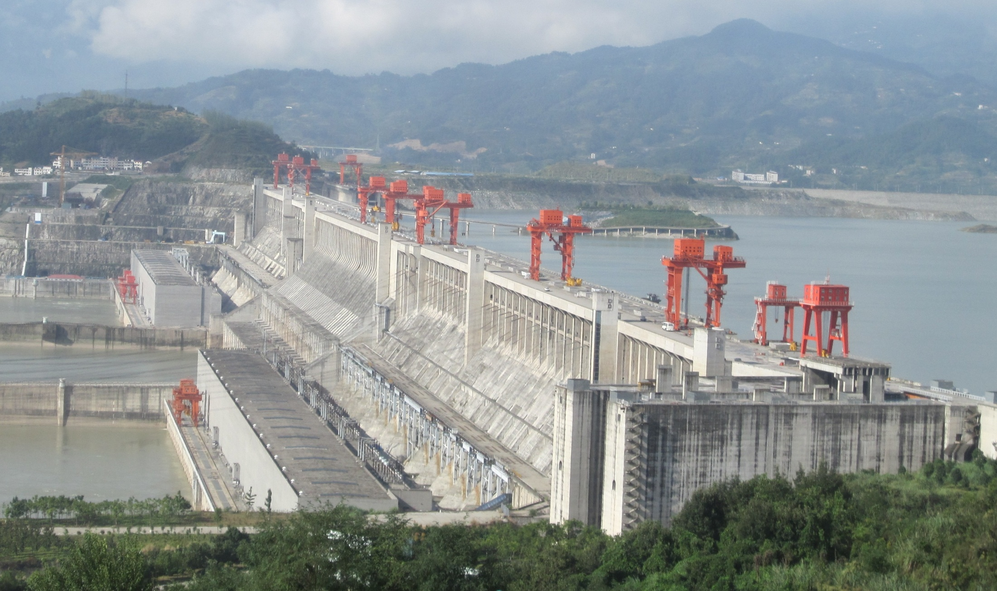
Engineering
The unreasonable effectiveness of data
Search, recommendation, prediction, …
Source: Wikipedia (Three Gorges Dam)

Slide 6
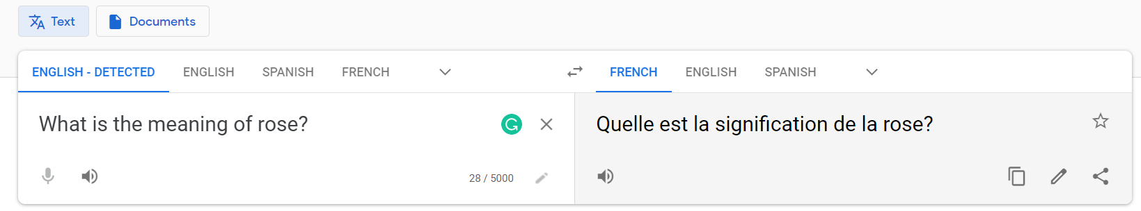
Language Translation

Slide 7
Big data analytics: Case Studies
Google
uses big data to improve search quality (ranked results)
Personalized ad recommendation
Youtube: Personalized video recommendation
Directions in Google map
Google translate: Language translation

Slide 8
Big data analytics: Case Studies
Netflix
On-demand streaming video for its customers
Predicts what the customers will enjoy watching with Big Data
Uses LOTs of historical data
Who watched what
Genre of the movie

Slide 9
Big data analytics: Case Studies
Uber
Uses personal data of the user to monitor which features of the service are mostly used
Focuses on supply and demand of the services
Finds out best routes depending upon factors such traffic, location, time etc
Fixing fare

Slide 10
Big data analytics: Case Studies
Walmart
Uses transaction data to discover patterns that can be used
Provides product recommendations
which products were brought together.
Organizing product in such a way that customers easily find it
Bread and butter in the same rack

Slide 11
Big data analytics: Case Studies
LinkedIn
Uses Big data to develop product offerings such as
people you may know
who have viewed your profile
jobs you may be interested in, and more
LinkedIn uses network/graph data to
analyze the profiles,
suggests opportunities according to qualification and interests

Slide 12
Big data analytics: Case Studies
Healthcare
Finding a disease outbreak
Predicting mental health from social media data
Human genome sequencing
identifying, mapping and sequencing all of the genes of the human genome from both a physical and a functional standpoint
Can be used to identify diseases and for better treatment

Slide 13
Focus of this course
Data Science
Tools
This Course
Analytics Infrastructure
Execution Infrastructure
“big data stack”

Slide 14
Buzzwords
Text: frequency estimation, language models, inverted indexes
Graphs: graph traversals, random walks (PageRank)
Relational data: SQL, joins, column stores
Data mining: hashing, clustering (k-means), classification, recommendations
Streams: probabilistic data structures (Bloom filters, CMS, HLL counters)
data analytics, business intelligence, OLAP, ETL, data warehouses and data lakes
Data Science
Tools
This Course
Analytics Infrastructure
MapReduce, Spark, noSQL, Flink, Pig, Hive, Dryad, Pregel, Giraph, Storm
Execution Infrastructure
“big data stack”
This course focuses on algorithm design and “programming at scale”

Slide 15
What is the Goal of Big Data Processing?
Finding useful pattern/insight/model from large data in reasonable amount of time
Primary focus is on efficiency as well as on information quality

Slide 16
Scalability of an algorithm
Growth of its complexity with the problem size
Time to finish
Memory requirement
How well it can handle big data?

Slide 17
Two Common Routes to Scalability
We will study all in detail
Improving Algorithmic Efficiency
Sampling techniques
Efficient data structures and algorithms
Parallel Processing
Scale-up architecture: Powerful server with lots of RAM, disk and cpu-cores
Scale-out architecture: Cluster of low-cost computers
Hadoop, Map-reduce, Spark

Slide 18
Scalability: Data Clustering
Create 10000 clusters from 1 billion vectors of dimension 1000
STEP 1: Start with k initial cluster centers (that is why k-mean ☺)
STEP 2: Assign/cluster each member to the closest center
Iterative steps
STEP 3: Recalculate centers

Slide 19
K-means: Illustration

Slide 20
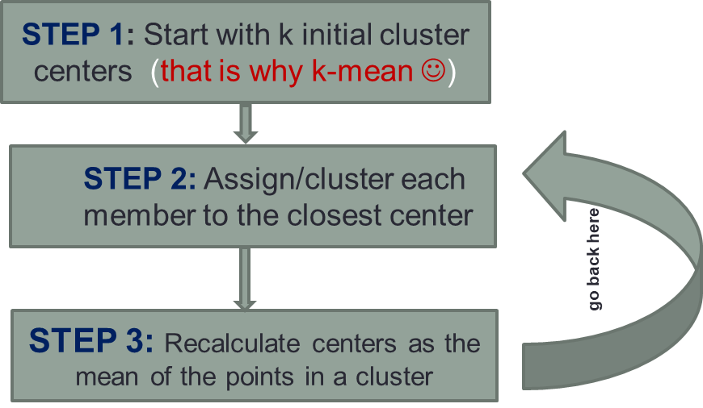
K-means: Initialize centers randomly

Slide 21
K-means: assign points to nearest center

Slide 22
K-means: readjust centers

Slide 23
K-means: assign points to nearest center

Slide 24
K-means: readjust centers

Slide 25
Kmeans: The Expensive part
Create 10000 clusters from 1 billion vectors of dimension 1000
STEP 1: Start with k initial cluster centers (that is why k-mean ☺)
STEP 2: Assign/cluster each member to the closest center
${10}^{10}×{10}^{3}×{10}^{4}={10}^{17}$
Iterative steps
STEP 3: Recalculate centers

Slide 26
Solution 1: Improving Algorithmic Efficiency
Sampling based k-mean
Take a random sample from the data
Apply kmean on that data to produce the approximate centroids
Key assumption:
The centroids from the random samples are very close to the centroids of the original data
Selective Search: Efficient and Effective Search of Large Textual Collections
by Kulkarni and Callan, ACM TOIS, 2016

Slide 27
Illustration: Sampling based k-mean
original centroids
Random sample
(30%)
kmean
Assign clusters to original data
approx centroids

Slide 28
Solution 2: Parallel Processing
STEP 1: Start with k initial cluster centers (that is why k-mean ☺)
Split data into small chunks
Process each chunk in different cores / nodes in a cluster
STEP 2: Assign/cluster each member to the closest center
Iterative steps
STEP 3: Recalculate centers

Slide 29
Pros and Cons
Sampling based method
Pros: Fast processing
Cons: Lossy Inference, Often Low accuracy
Scale-up Architecture
Pros: Fast processing (if data fits into RAM)
Cons: Risk of data loss (system failure), Scalability issue for very large data
Scale-out architecture
Pros: Can handle very large data, fault tolerant
Cons: Communication bottleneck, difficulty in writing code

Slide 30
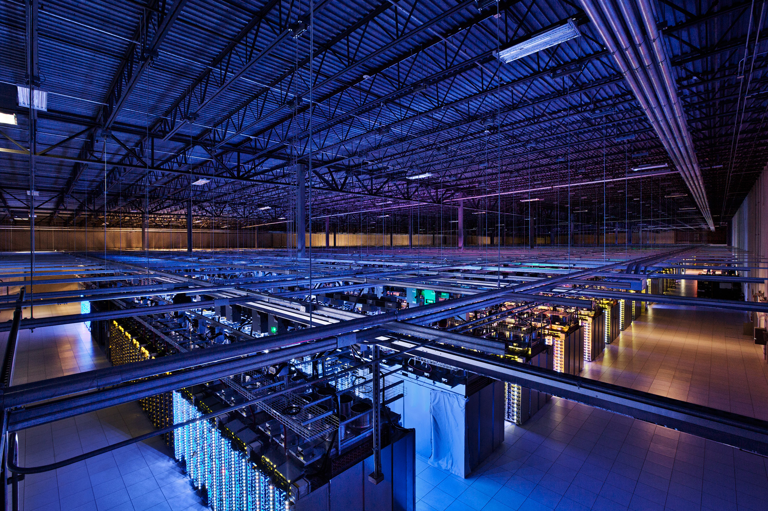
How to Tackle Big Data?
Source: Google

Slide 31
Divide and Conquer: the good, old and reliable friend
“Work”
Partition
w₁
w₂
w₃
worker
worker
worker
r₁
r₂
r₃
Combine
“Result”

Slide 32
What are the Challenges?
How do we assign work units to workers?
What if we have more work units than workers?
What if workers need to share partial results?
How do we aggregate partial results?
How do we know all the workers have finished?
What if workers die?

Slide 33
A Critical Issue
Parallelization problems arise from:
Communication between workers (e.g., to exchange state)
Access to shared resources (e.g., data)
Thus, we need a synchronization mechanism

Slide 34
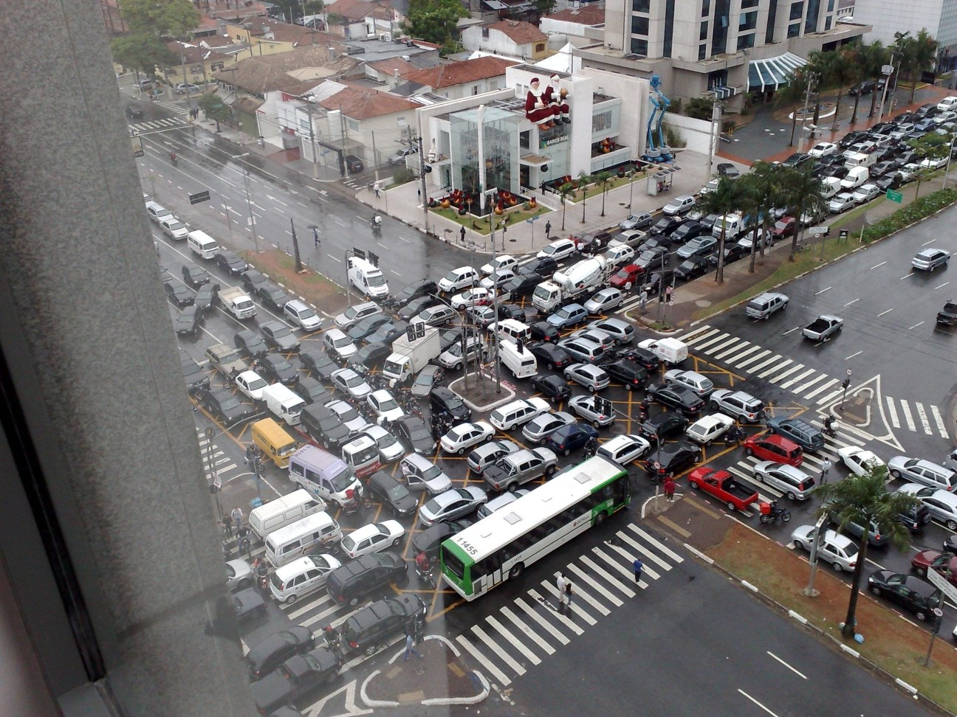
Bad synchronization!!
Source: Ricardo Guimarães Herrmann

Slide 35
Old Tools for Big Data Processing
Shared Memory
Message Passing
Programming models
Shared memory (pthreads)
Message passing (MPI)
Design Patterns
Master-slaves
Producer-consumer flows
Shared work queues
Memory
P₁
P₂
P₃
P₄
P₅
P₁
P₂
P₃
P₄
P₅
producer
consumer
master
work queue
slaves
producer
consumer

Slide 36
Thank you so much!!

